Slide 1
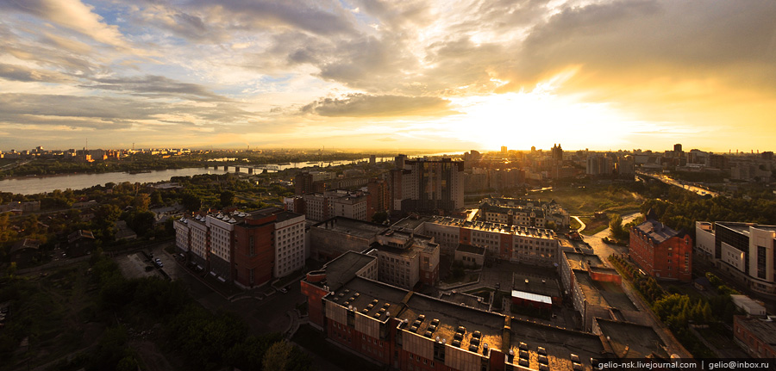
Bachelor Degree Programs
PROGRAM
PSYCHOLOGY
siu.ranepa.ru

Slide 2
Expertise of the Graduates Field of Expertise
Bachelor's degree
37.03.01. – PSYCHOLOGY :
Solve complex tasks
in education, healthcare, culture, sport, defence, administrative, and legal areas, as well as in social care
at public and economic organisations, administrative bodies, scientific, research, and consulting organisations providing psychological services to individuals and organisations.
Specialist degree
37.05.02. – PSYCHOLOGY IN SERVICE ACTIVITIES
Solve complex tasks
psychological support in administration,
activities of personnel and departments of law enforcement services,
defence, protection of individuals, society, and state,
social care,
organisation of operation of psychology services for individuals and organisations; psychology in education.

Slide 3
More than 40 study guides
2007 - Recommended by the Psychology Council of the Academic Methodological Association for university classical higher education as a training guide for students of psychological specialities

Slide 4
2008 г.

Slide 5
2010 - Recommended by the Psychology Council of the Academic Methodological Association for university classical higher education as a training guide for students of psychological specialities

Slide 6
Recently we have had an increased number of applications from various state and municipal bodies of the Siberian Region for training, retraining, and advanced training of students and course participants in specialities of the Siberian Institute of Management – branch of RANEPA, related to psychological support of activities in the following programs:
Leader’s Personality in the System of Public Administration;
Psychology of Professional Activities of Civil Officers;
Modern Psychological Researches in Evaluation of Potential of Civil Officers;
Psychological Evaluation of State and Municipal Civil Officers for Creation of Personnel Pool;
Development of Personnel Strategies at Regional and Municipal Levels, etc.

Slide 7
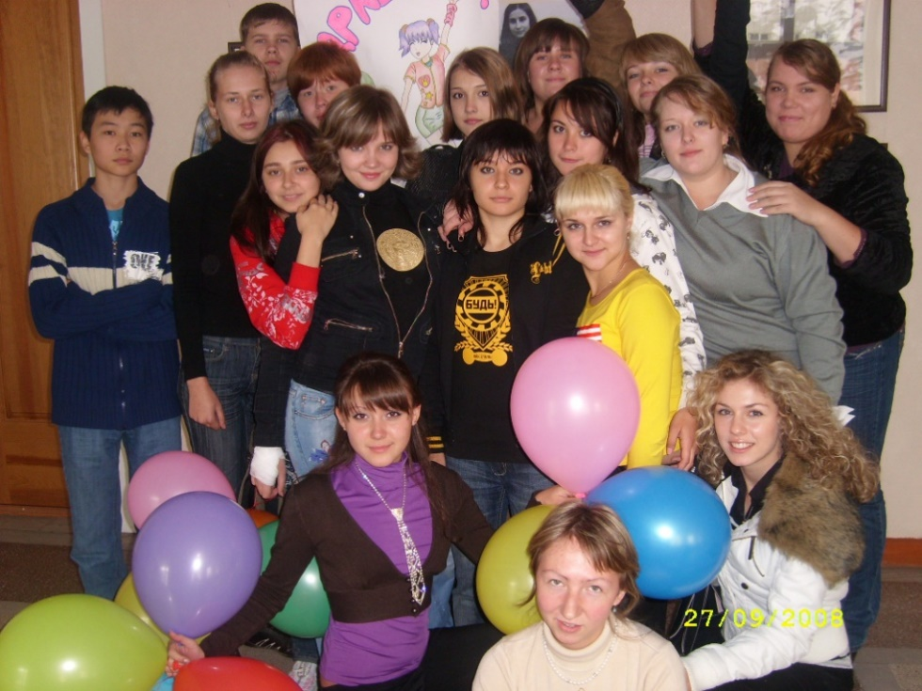
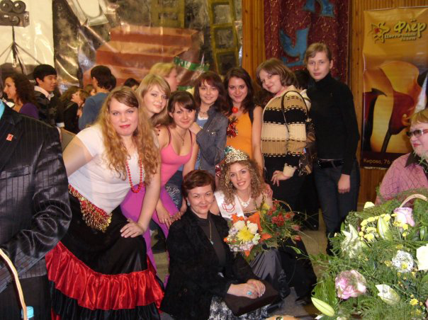
Preparation for the Day of the Freshman

Slide 8
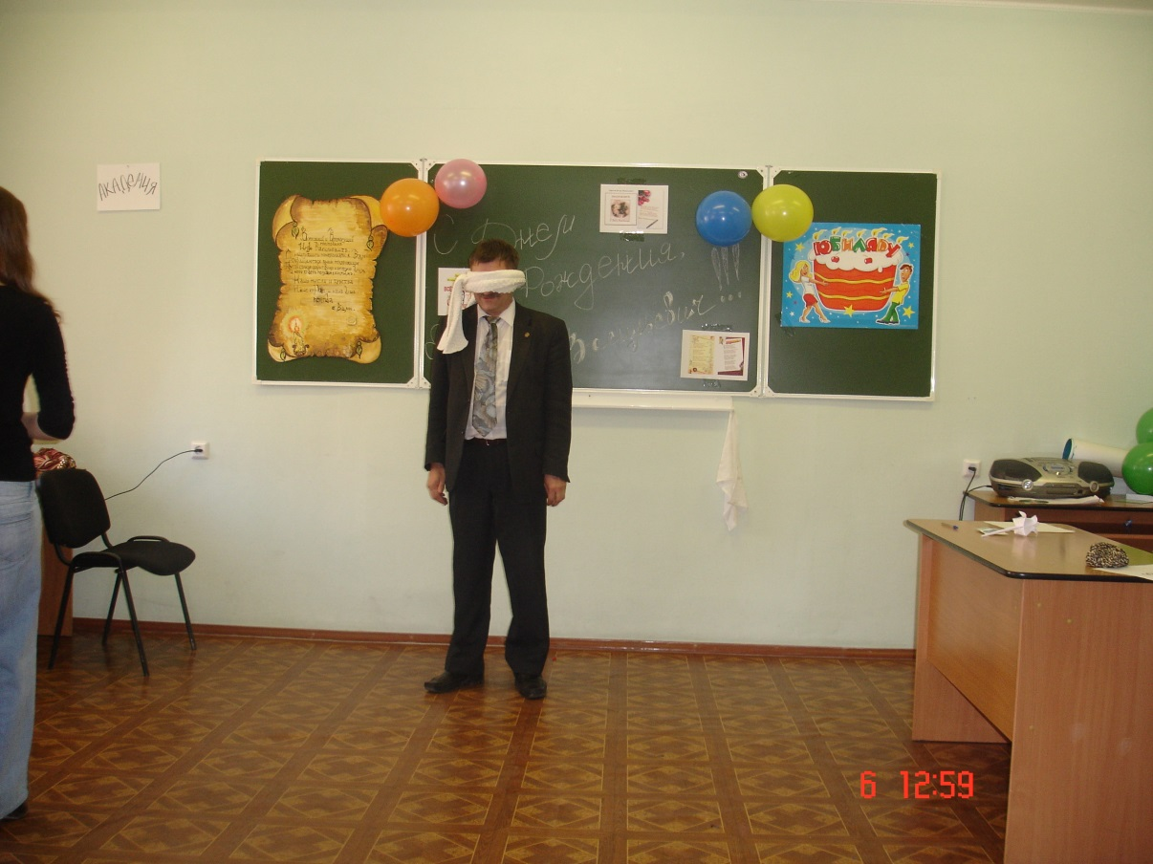
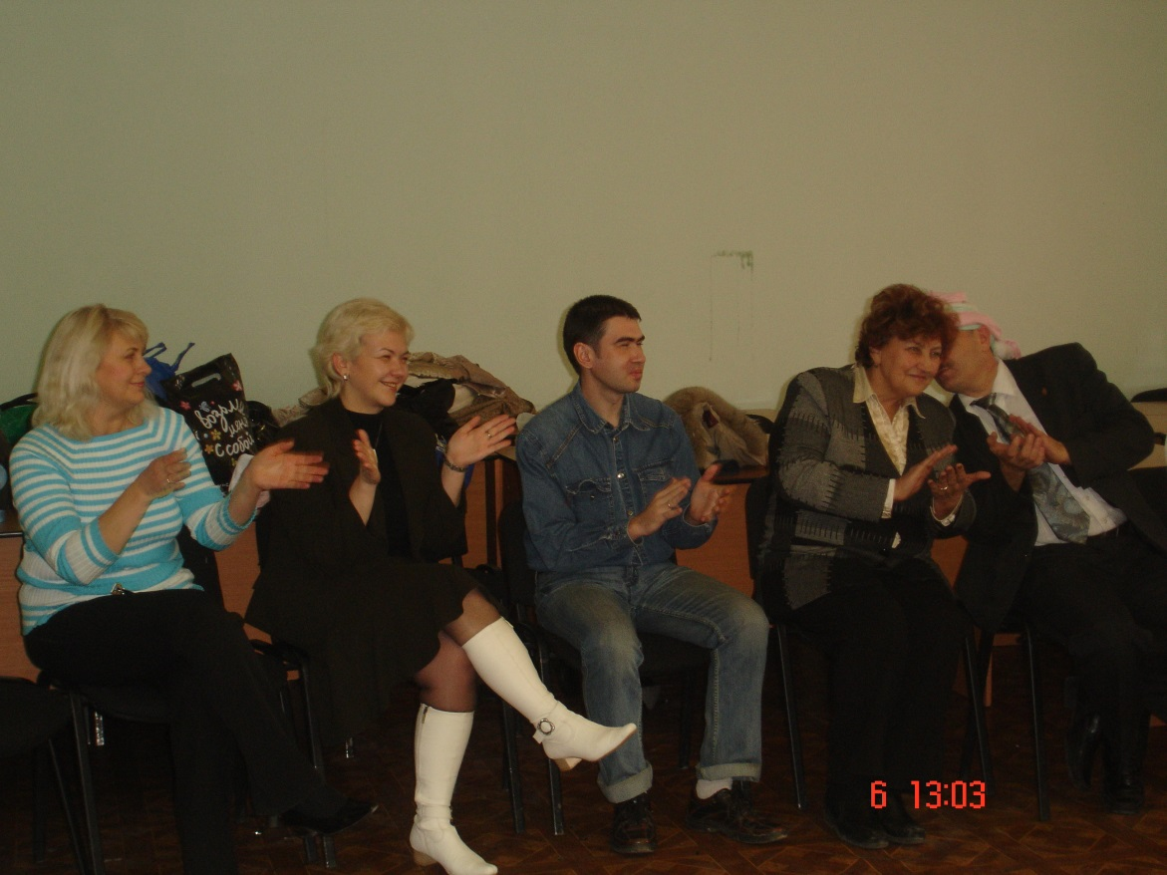
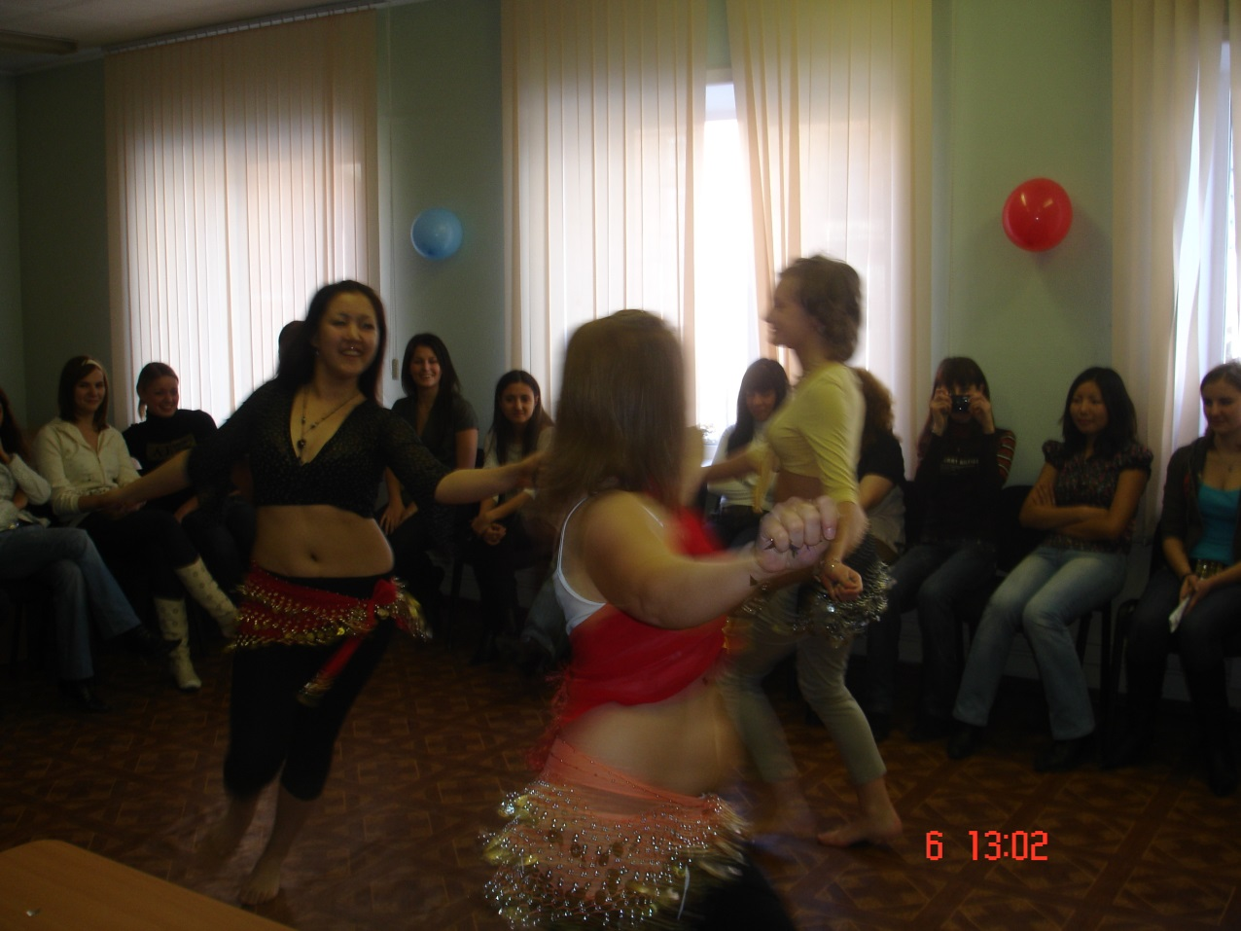
Creative competitions

Slide 9
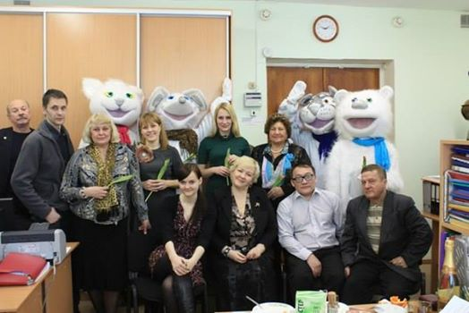
Creative meetings

